Slide 1
Before There Were Stars
R. Shawn Hewitt, Peter Huntoon
Memphis Speakers Series
2014 Memphis
International Paper Money Show
Notes:
Handouts provided courtesy of SPMC.

Slide 2
Large Size Pre-Star Replacement Notes
R. Shawn Hewitt, Peter Huntoon
Memphis Speakers Series
2014 Memphis
International Paper Money Show
Notes:
A better title might be: Large Size Pre-Star Replacement Notes
This is the second part of a series I started last Memphis with my talk on Large Size Replacement National Bank Notes. Some of the material will be from my talk last year.

Slide 3
Notes:
And, today we’re going to take the scenic route. What’s fun about researching this stuff is finding the unexpected, and I’ll be sharing some of these ancillary things along the way.
I’m going to go a little deeper than I need to on the background information, but its all good.

Slide 4
Large Size Pre-Star Replacements
Background
How to Identify Them
Statistics
Notes:
This is what we’re going to do…

Slide 5
Background
History of Replacements
Notes:
Let’s get started…

Slide 6
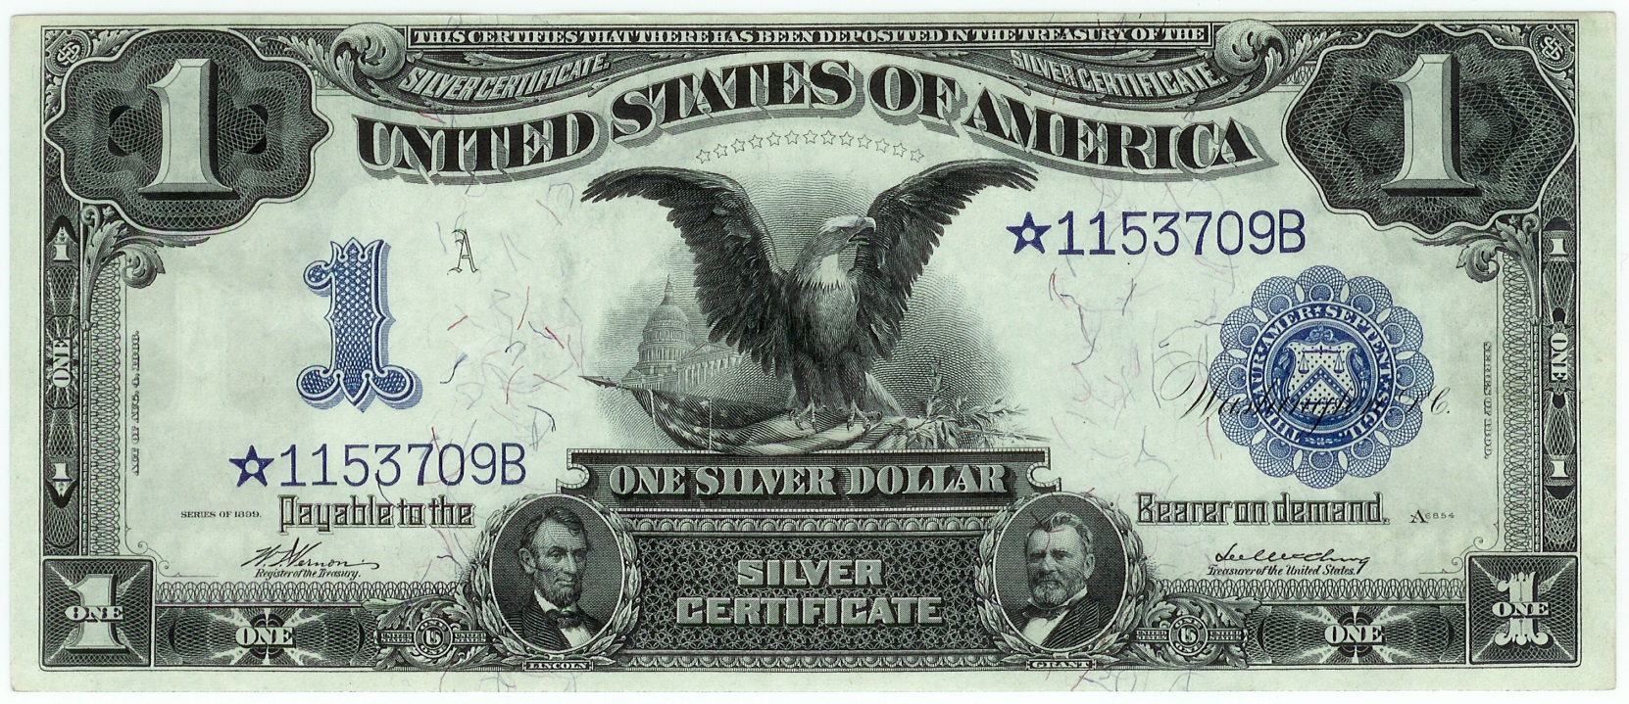
Star Notes
Notes:
We’re going to start with a common frame of reference.
Most of you will recognize this familiar note – these are usually known as star notes, so named for the star character in front of the serial number.
These notes were used to replace defective notes as they were caught at the BEP. They were independently numbered, and printed in advance of a normal production run.
Star notes were first introduced in 1910.

Slide 7
Replacements
Made to replace defective notes caught at the BEP
Why?
Maintain counts in packs and packages
Notes:
Why did the BEP bother at all with making replacement notes?
Simply to maintain counts in packs and packages.

Slide 8
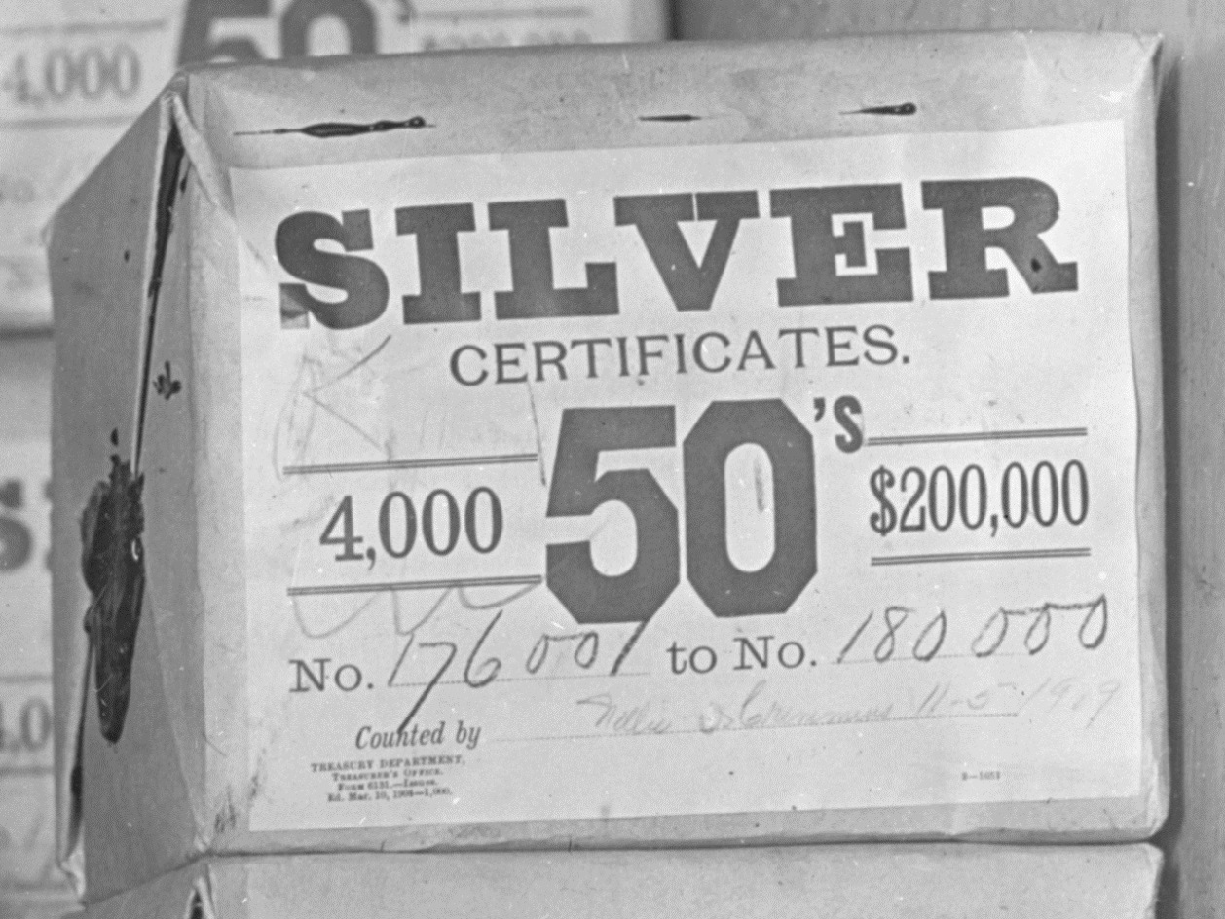
Packages were to have fixed serial number ranges
Notes:
Like this early package of 4,000 notes in the vaults of the Treasury.
Imagine how confusing it would be for the vault clerks, record keepers and auditors if the packages had odd ranges of serial numbers. As you can see, this package has a clean range of serials. This is the 45th package of $50 Silvers.
Another thing to remember is that the BEP was essentially a contract printer for the Treasury. For its inventory of currency, the Treasury wanted to have packages of currency ready for distribution, like this. The Treasury ordered “perfect” notes, and that is what it expected.

Slide 9
Replacements
Star notes introduced in 1910
What did the BEP do to replace defective notes before 1910?
Notes:
As I mentioned earlier, star notes were introduced in 1910 to replace defective notes.
What did the BEP do to replace defective notes before then? That’s what we’re going to investigate today.

Slide 10
Exact Replacements
Why go to the trouble of making exact replacements?
Treasury ordered perfect notes.
It was policy.
Notes:
The solution of that era – before 1910 - was to make exact replacements for defective notes, meaning that notes identically numbered to the defective notes had to be fabricated.
Why bother?
I just said a moment ago that counts had to be maintained. Why not insert another number in place of a defective?
When Treasury placed an order for 100,000 notes with serials 1 to 100,000, that is what the BEP was supposed to deliver. It required perfect notes.
It was the policy of the day. They had to go back and make-up the note with the same serial number.

Slide 11
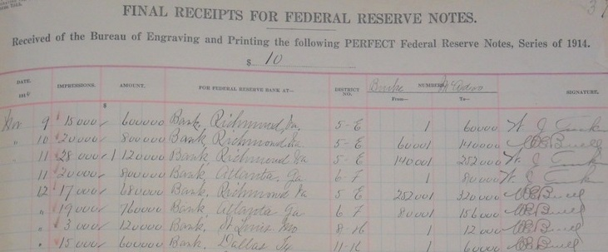
“PERFECT”
Notes:
In fact, even the Treasury ledger titles made the point. This is a ledger page of notes received from the BEP.
Perfect was the name of the game.

Slide 12
Exact Replacements
The Big Picture…
Great concern for integrity, and security against fraud and over-issue
Notes:
I also want to tell you about the bigger picture – more background information – of BEP production in the late 1800s:
Starting in the mid-1880s, there was an emerging demand for accountability and scrutiny of the Treasury Department.

Slide 13
Fraud Prevention Measures
End characters
Notes:
It lead to fraud prevention measures, like the use of end characters on serial numbers to help prevent alterations.

Slide 14
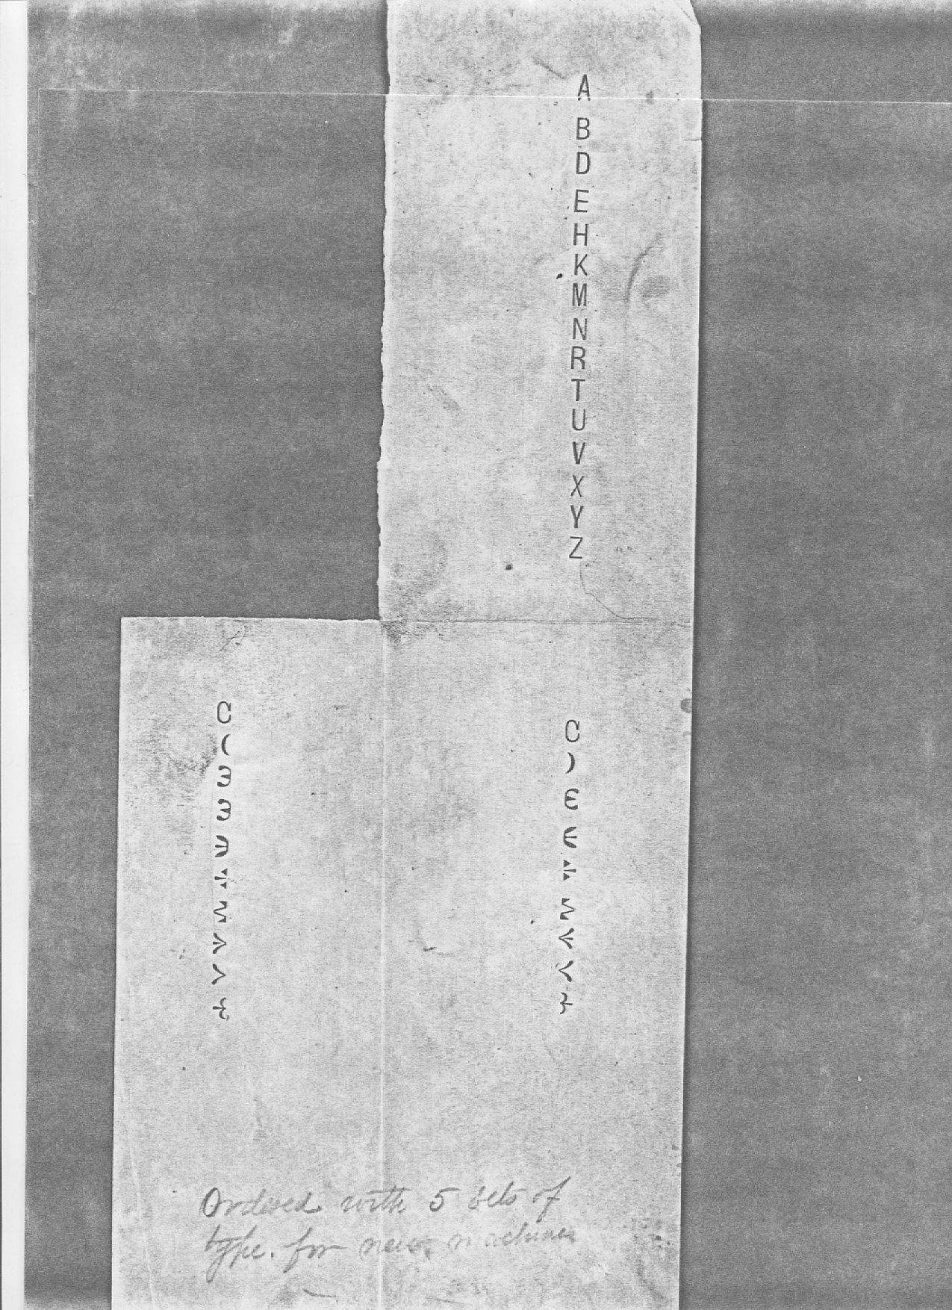
Notes:
Like these guys.
This is a sample impression of end characters found in the archives by Doug Murray many years ago.

Slide 15
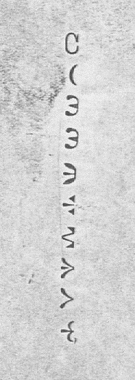
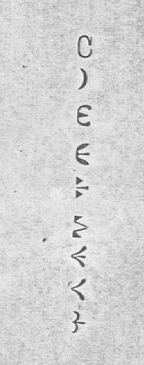
End characters
Notes:
Here’s a closer look. You’ll recognize many of them.
The Cs were used as prefixes on gold certificates.
The parentheses were used on national bank notes and certain high denomination notes.
The epsilons
The flowers on silver certificates
The braces on national bank notes.

Slide 16
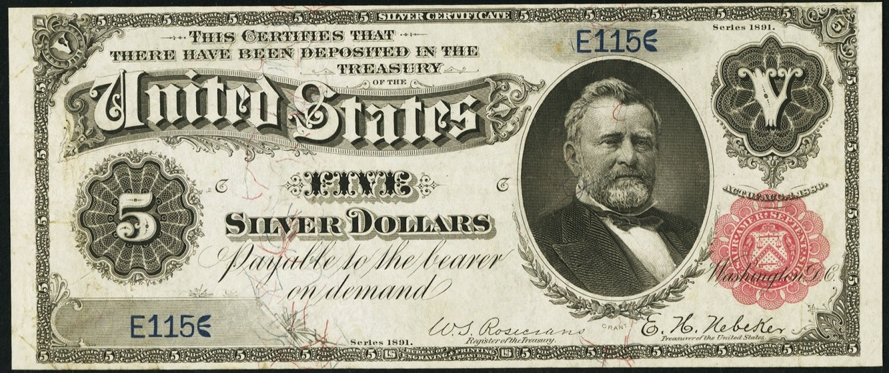
End characters

Slide 17
Fraud Prevention Measures
End characters
Special fonts (Smith patent)
Notes:
As another fraud prevention measure, the BEP even employed the use of specially patented fonts.

Slide 18
U.S. Design Patent 7079
Notes:
These may look familiar to you. What you may not know is that were patented by James D. Smith in 1873. Smith was an engineer at the BEP and is credited for a number of patents, many of which have to do with numbering machines.
He specifically designed this font set so that numerals could not be altered without detection…

Slide 19
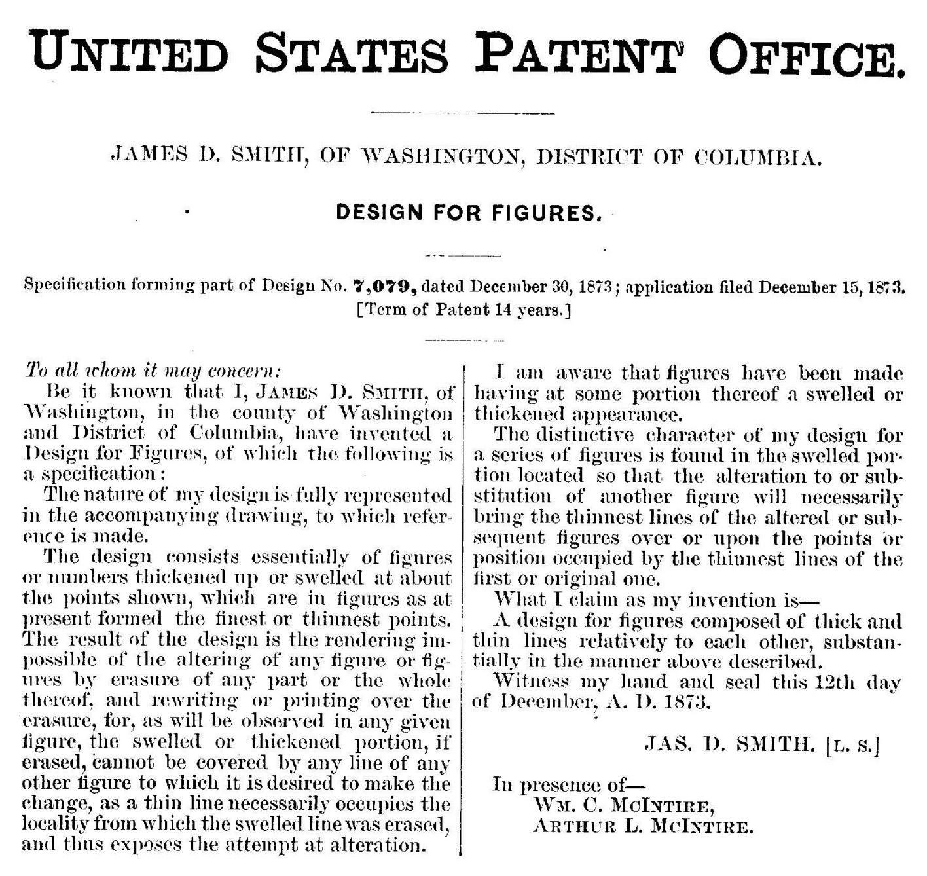
Notes:
Here is the patent description.
The upshot is that “The result of the design is the rendering impossible of the altering of any figure … by erasure…”

Slide 20
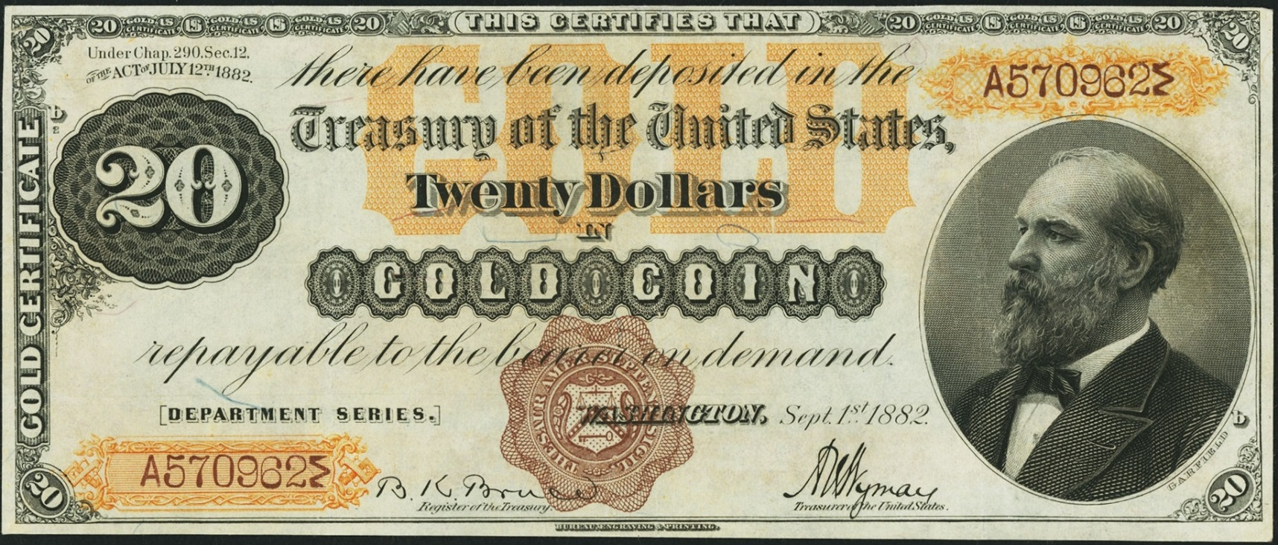
As seen on early 1882 GCs
Notes:
And it was put into use on early 1882 Gold Certificates.
They were perhaps the oddest looking fonts used on serial numbers.

Slide 21
Fraud Prevention Measures
End characters
Special fonts (Smith patent)
Sealing at the Treasury (1885 to 1910)
Notes:
The crescendo of all this was that the sealing process – by that I mean the application of the Treasury Seal and any colored ornamentation – was transferred from the BEP to the Treasury in 1885.
This is something that I did not know until very recently.

Slide 22
Sealing at the Treasury
Began in 1885 at the recommendation of a committee headed by newly inducted Treasury officials
Cited reasons
The final authentication and monetization of currency should occur elsewhere from they are created.
Money in transport from BEP to Treasury might be at risk of being stolen.
Notes:
Began in 1885…
…they were officials of the Grover Cleveland administration, that included Treasury secretary Daniel Manning and Treasurer Conrad Jordan.
The cited reasons for the policy change: Committee concluded that paper money at the BEP should be distinguishable from monetized currency at the Treasury. There was also a supposed risk of theft of currency in transport to the Treasury, and it was thought that if this currency was not sealed, it would not be able to pass as money.
To recap, all printing up to and including serial numbers was done at the BEP. Then, unfinished sheets were sent to the Treasury, where seals were applied, the sheets cut and the notes sorted into packages.

Slide 23
Exact Replacements
It was one part of the overall policy
Policy was eventually overhauled in 1910
Notes:
So that provides the background as to why exact replacements were needed. It was part of the overall effort to ensure the integrity of U.S. Currency.
Policy was eventually overhauled in 1910.

Slide 24
How were replacements made?
In order to answer that question, we have to briefly talk about the technology used to number the notes

Slide 25
Numbering Technology at BEP
Foot activated numbering machines, called paging machines
Single action - impressed one number at a time
Designed and made in-house
Patented in 1874 by BEP employee James D. Smith
Notes:
BEP had a special division (Numbering Division) whose job it was to number currency and other financial instruments printed at the facility.
The early numbering machines were rather primitive. They were foot activated with a treadle, like a sewing machine. And they were single action – meaning only one number was impressed at a time.
They were called paging machines.
These numbering machines were the brainchild of BEP employee James D. Smith. This is what it looked like on paper…

Slide 26
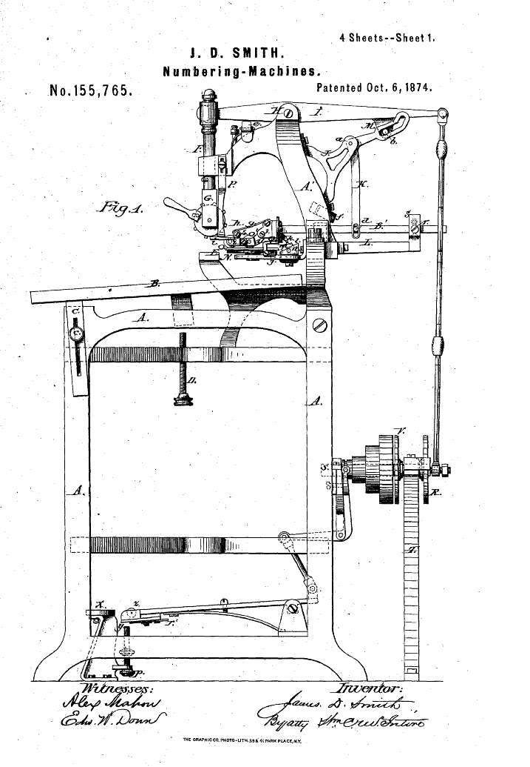
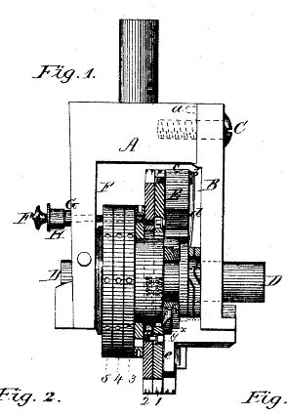
Notes:
This is a diagram that was filed with the patent application for this device.
To number a sheet of type notes, the operator needed to place the sheet in the exact location relative to the numbering head starting at the top, depress the foot treadle to make an impression, repeat for the second number on the note, and then pull the lever to advance the number for the next note. The process was then repeated for the remaining three notes on the sheet.
On the right is a close up of the numbering head, which is the part that makes contact with the paper.

Slide 27
Numbering Technology in 1890
Notes:
Here it is in practice. A lady operator is numbering Silver Dollar Backs. The same presses were used for type notes and national bank notes.

Slide 28
Paging Machine
Notes:
Here is a closer look. The sheet is bent over the platen. Precision was very important, just like sewing with a treadle sewing machine.

Slide 29
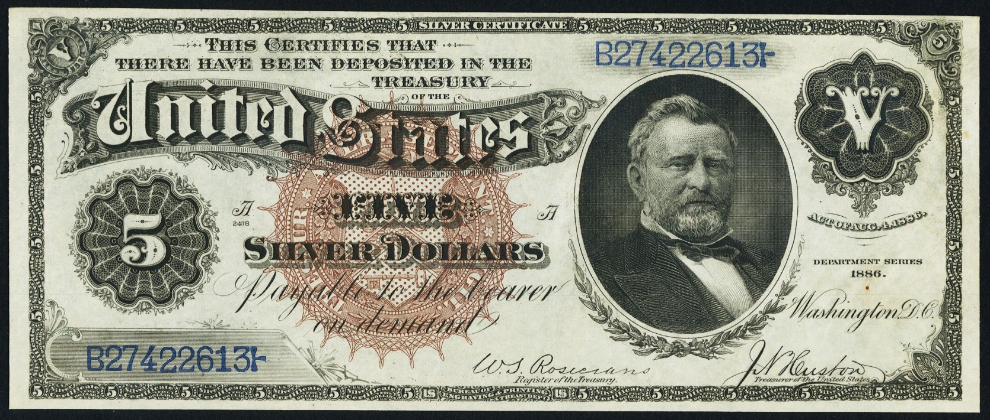
The Finished Product
Notes:
Here is the finished product. Take a look at the serial numbers – the fonts in particular. They have a certain style to them.

Slide 30
Making Replacements
With the technology of the paging machines from 1870s to 1903, making replacements was relatively straightforward.
Notes:
Making replacements was fairly straightforward. If you have a defective sheet, have an operator make a new one: simply dial in the same number as the sheet that was defective, number the sheet, and put it in its appropriate place in the stack of sheets.

Slide 31
1903: New Technology
Notes:
In 1903, there was a huge technological innovation: The Rotary Press.
From 1904 “The Making of Government Securities” by BEP Director William Meredith.
One innovation mentioned here: “The machines change the numbers automatically”. But it did a lot more than that.

Slide 32
Another Innovation by James Smith
Notes:
From the 1908 Congressional Record. A survey of government employees that had filed patents.
The machine was rotary in nature, enabling it to print several sets of serials in a single pass.

Slide 33
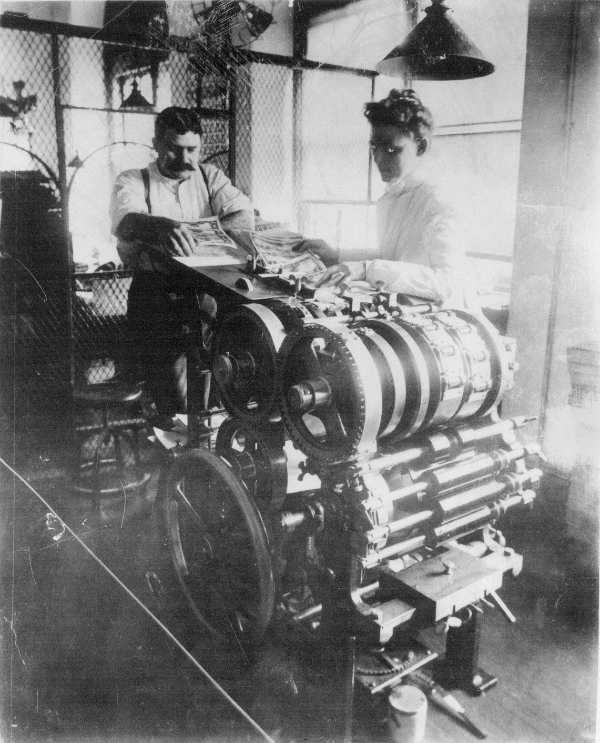
Numbering Technology in 1903
Notes:
Here it is at work numbering Black Eagles.
The press operator was the lady. The BEP had a corps of women for this purpose. Men were employed to collect the numbered notes and inspect them as they came out.

Slide 34
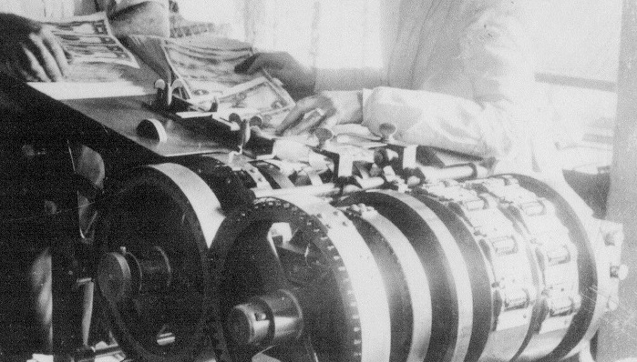
Notes:
To number an entire sheet in a single pass on a rotary press was quite the “revolution.” Perhaps being 10x faster than using paging machines.

Slide 35
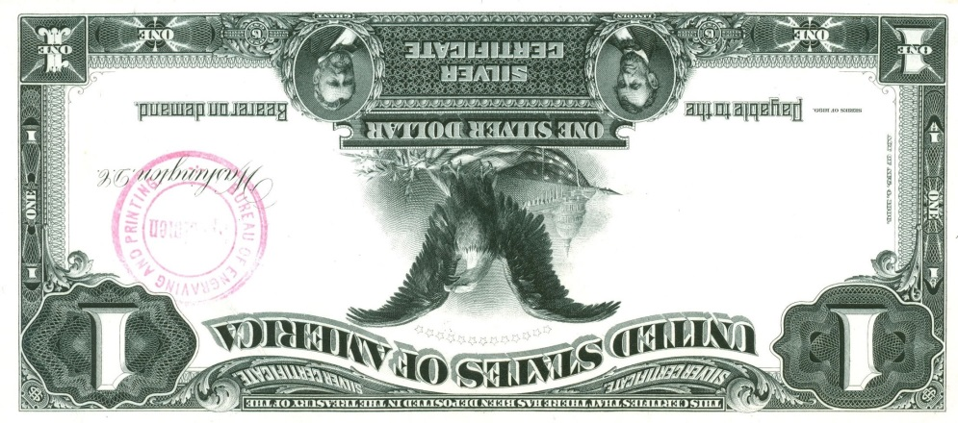
Plate Position C
Right Serial
Left Serial
Plate Position D
Notes:
Here is my operational diagram. Sheets were fed in top down. The eight numbering heads impressed the numbers in the correct positions.
Notice, too, that the heads were adjustable within the drum.

Slide 36
Different numbering machines used different fonts
Droopy 2
Hunchback 3
Long-handled 4
Closed fonts
Notes:
The interesting thing is that a technical quirk allows us to distinguish notes printed on paging machines vs. rotary presses: the fonts on the two kinds of machines were different.
Top row are the old style fonts associated with paging machines. Bottom row are the new style fonts associated with the rotary press and later incarnations of serial number application.
The most distinctive numerals are the Droopy 2, hunchback 3, long-handled 4.

Slide 37
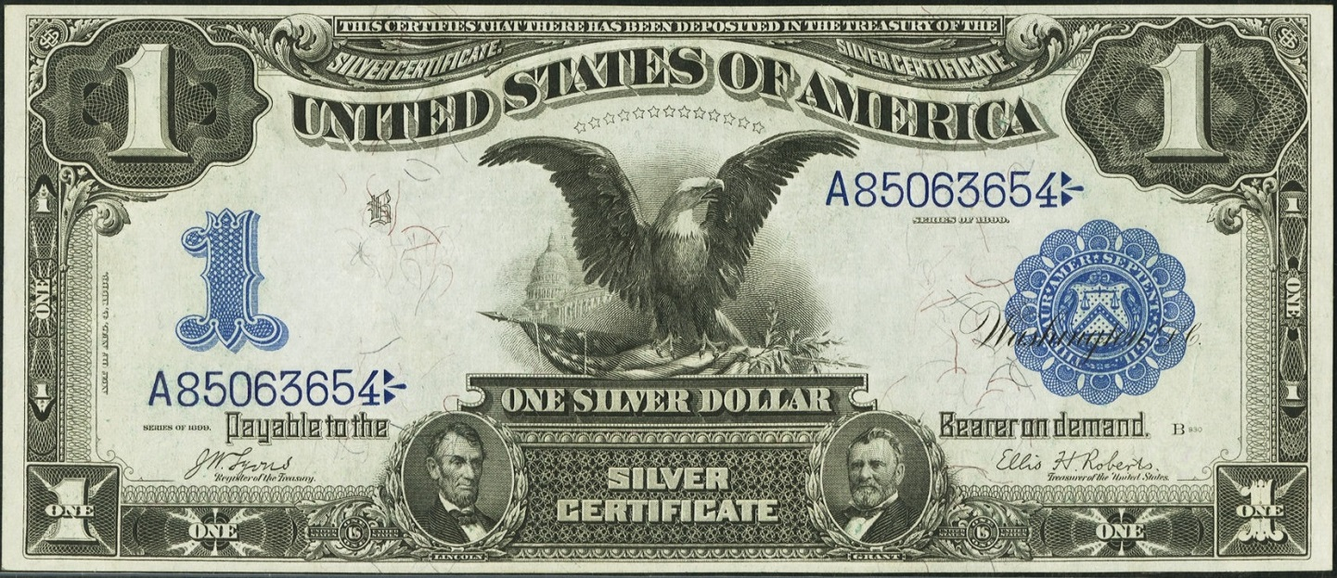
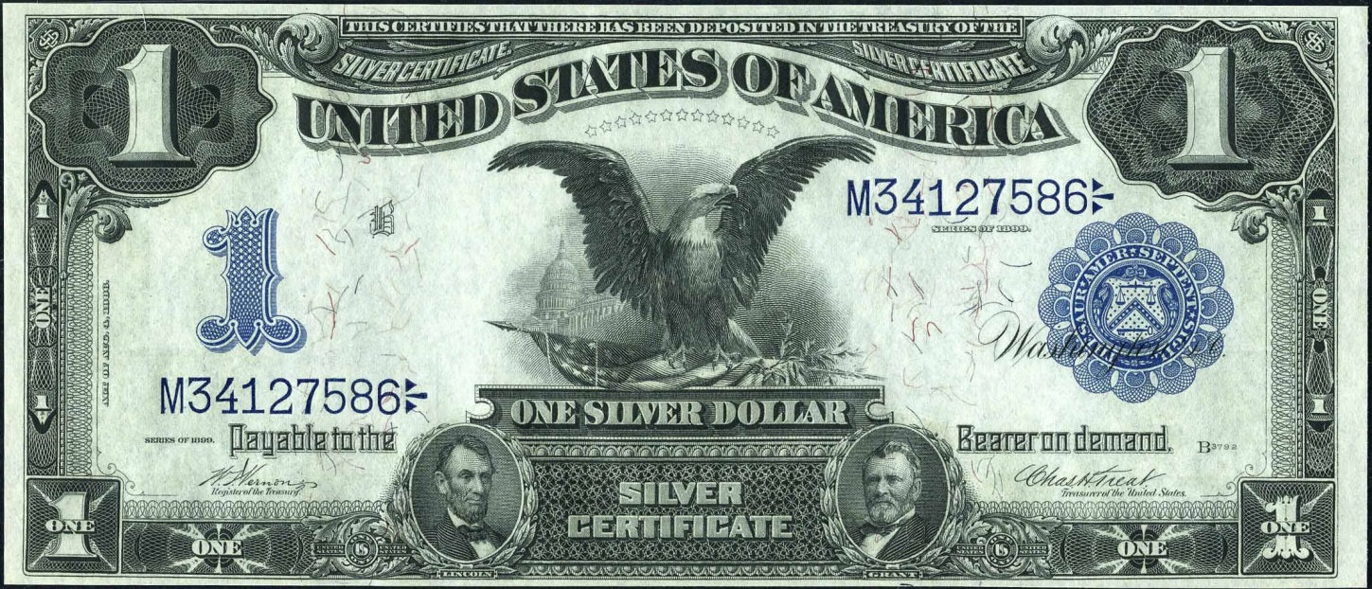
Black Eagles – Before and After
Notes:
Images of pre-1903 and post-1903 Black Eagles.

Slide 38
Making exact replacements after introduction of rotary presses
Use a new rotary press?
Way too time consuming
Would mean downtime of a valuable resource
Notes:
You might at first think that to make a replacement sheet in this new technological era, you’d take it to an idle rotary press and reset the numbering heads to match the numbers that you needed to replace.
Way too time consuming.
Would mean downtime of a valuable resource – there were no idle rotary presses. All were being used to number as many sheets as possible.

Slide 39
Sometimes low tech solutions are best
Old manual serial number presses – paging machines – were retained for the purpose of replacing defective sheets with perfect identically numbered sheets.
For a single replacement, it was easier to make a new sheet using the old press than to reset the numbering heads on the rotary press – and hold up production in the process.

Slide 40
Key point of this research
We can identify pre-star replacements
Printed after 1903
Serials printed with paging machines

Slide 41
Why were exact replacements phased out?
Treasury was replacing misprints without regard for serials anyway…
Notes:
Why were exact replacements phased out? There were a few reasons… One is that the Treasury was replacing misprints with indiscriminately numbered notes anyway.
Some misprints did make their way past the BEP to the Treasury. It was more often the case that the Treasury made a mistake during the sealing process. They didn’t want to go back to the BEP and ask for make-up notes.

Slide 42
BEP Director to Treasurer, April 14, 1910
…In this connection I would also bring to your attention another matter which largely affects the rapidity with which the examination of the separated notes may be accomplished. The present method at the Bureau is to replace all defective notes with perfect ones which are specially numbered in order that the sequence of numbers to your Office may be unbroken, but this seems to be an unnecessary care and labor inasmuch as the practice in your Office is to destroy imperfect notes and replace them with notes drawn from your reserve stock without regard to the sequences of the numbers. It is therefore suggested that this Bureau be authorized to prepare a stock of notes numbered in sequence, beginning with 1, and distinguished from all other notes by the special letter or character printed before and after the number and that any one of these notes be substituted in place of any defective note, a record being made on the package to indicate to your Office that it contains such substituted note or notes…
Notes:
Check out this excerpt from a letter from BEP Director to the Treasurer.

Slide 43
Why were exact replacements phased out?
Treasury was replacing misprints without regard for serials anyway
Transfer of sealing back to BEP in 1910
New Harris Press
Numbered, sealed and cut notes
Single notes instead of entire sheets could be replaced
Notes:
Another reason is that the sealing of notes was transferred back to the BEP in 1910. The volume of notes coming out of the BEP required a policy change simply to keep up with production. Making exact replacements was no longer practical.
Finally, the new Harris Press was a tremendous innovation. It numbered, sealed, cut and collated the notes. And, single notes instead of entire sheets could be replaced.

Slide 44
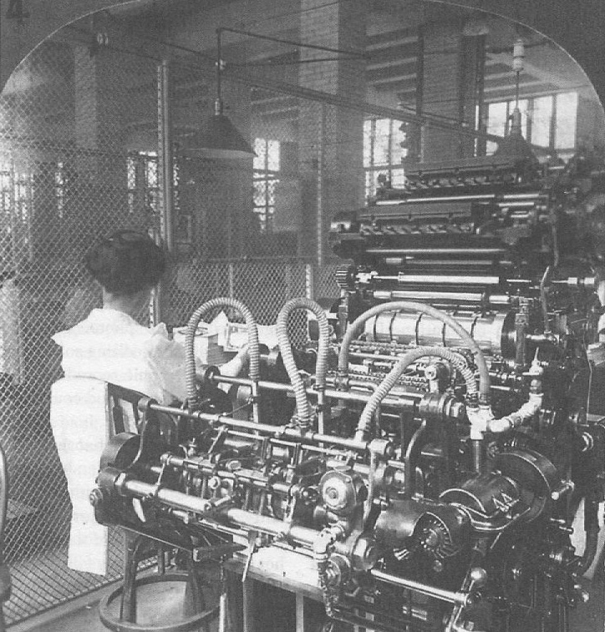
Numbering Technology in 1910
Notes:
Here’s a look at the Harris Press.

Slide 45
Technology drove Policy
The BEP and Treasury had to adapt in order to meet their currency production targets
Newer, better technology
Eliminate old, useless policies
Notes:
To sum up what was happening in 1910, it was that technology drove policy.
They had new, better technology which required them to eliminate old, impractical policies.

Slide 46
How to Identify Pre-Star Replacements
It’s easier than you think

Slide 47
Identification
Remember that this research covers period after 1903
After BEP changed fonts to new style
We don’t yet know how to identify replacements made before this time
Does not cover post-1882 series gold certificates

Slide 48
Identification
Old Style Fonts
PSRs
Printed after 1903
Notes:
Many of us are visual learners, so I’d like you to remember this when evaluating whether a note is a PSR.

Slide 49
Stars not used on large-size high denominations
$500 and up continued to use “make-up” notes.
Notes:
This is where I want to talk for a moment to clarify the nomenclature.
Term “make-up notes” is more technically correct because it includes groups of notes for which stars were never made. There can’t be “pre-star notes” for a group if there were no stars.
Despite this, I like the use of the term “Pre-star replacements” because in the overall context it better conveys what they are.

Slide 50
Technique
Printed after 1903
Refer to Table for candidate serial ranges
Old Style Fonts
Left and right serials impressed from the same numbering head
Serial numbers >= 1000
Other clues
Slightly skewed numbers
Slightly over-inked
Notes:
Here’s the technique to identify a PSR…
Must be printed after 1903. Peter and I have done the work to identify the serial number ranges of candidate notes. We’ll show that to you momentarily in a table.
Must have old style fonts.
We had to add a couple criteria to eliminate some red herrings; we’ll also show you some of those.

Slide 51
Serial number ranges from which pre-star replacement notes among
Legal Tender Notes, Silver Certificates and Gold Certificates can be identified
Impacted Serial Friedberg Date of First Use
Denom. Series Number Range¹ Prefix Letters Numbers² of Star Notes
Legal Tender Notes:
$5 1907 A1-B8292000 A,B 83-84 June 21, 1910
$10 1901 20000001-D4000000 no prefix, A,B,D 114-117 August 9, 1910
$20 1880 A1-D408000 A,B,D 143-145 circa 1915-1919
Silver Certificates:
$1 1899 B30000001-V75612000 B,D,E,H,K,M,N,R,T,V 226a-229 June 21, 1910
$2 1899 56000001-E16176000 no prefix, A,B,D,E 249-252 July 15, 1910
$5 1899 88000001-E17700000 no prefix, A,B,D,E 271-275 June 21, 1910
$10 1908 A1-B1164000 A,B 302-303 May 11, 1914
$20 1891 E8600001-E9104000 E 320 May 21, 1914
$50 1891 E900001-K812000 E,H,K 333-335 Not used
Gold Certificates:
$20 1882 C11700001-C16544000 C 1178 Not used
$50 1882 C1200001-H1604000 C,D,E,H 1193-1197 Not used
$100 1882 C900001-M1420000 C,D,E,H,K,M 1206-1214 Not used
1. The beginning serial is the estimated first use of rotary press numbering machines for the type after those machines went into production in September 1903 and is subject to revision. The ending serial the last serial printed before the use of star notes began (Murray, 1996, p. 9-10).
2. Range of Friedberg catalog numbers for impacted types.
Notes:
How do we know if a note was printed after 1903? That’s what this table is for.
This chart is in the handout. Use it to identify serial number ranges when PSRs were made.

Slide 52
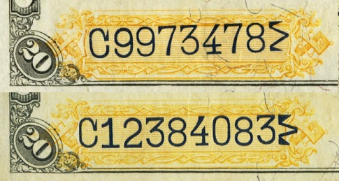
Before and after 1903
Notes:
Examples of pre- and post-1903 serials. Serial number changeover in this series was about 11,700,000.

Slide 53
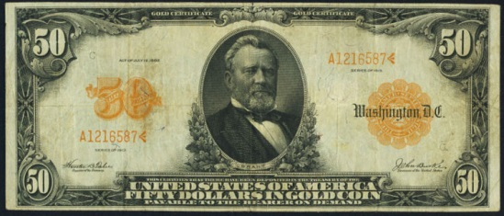
What about post-1882 Gold Certificates?
1905, 1906 $20s
1907 $10s
1913 $50s
Notes:
Notice on the table that for Gold Certificates, only Series of 1882 notes are listed.
Later series have small serial numbers. The present research does not apply to them.

Slide 54
Paging machines used old style fonts
Droopy 2
Hunchback 3
Long-handled 4
Closed fonts
Notes:
What do the old style fonts look like?
…as seen in the top row.
Also in the handout.

Slide 55
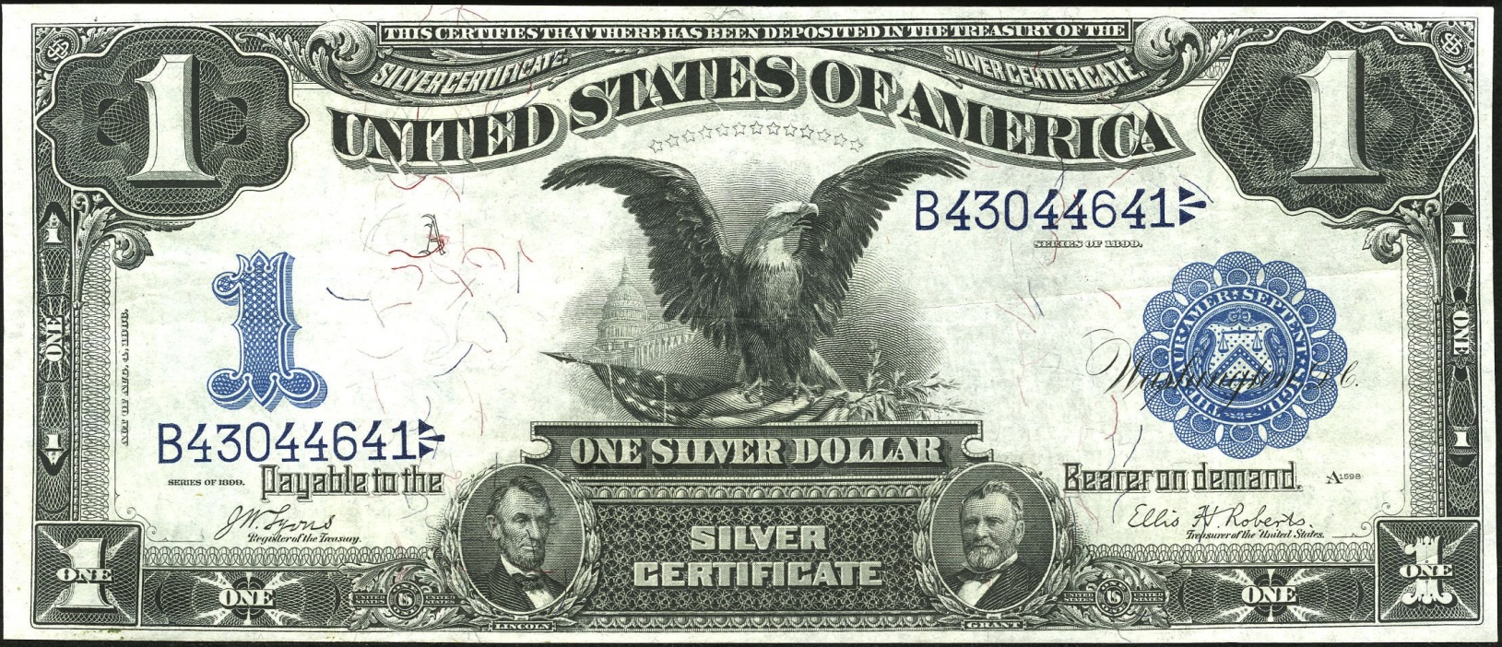
Catch #1
Notes:
What are the red herrings? Here’s one…
This is because the right serial has old style 4s, but the left numbers are new style. This note was numbered with a rotary press.
For a PSR, the serials must have been impressed with a paging machine. The way we can tell is that both left and right serials need to look identical.

Slide 56
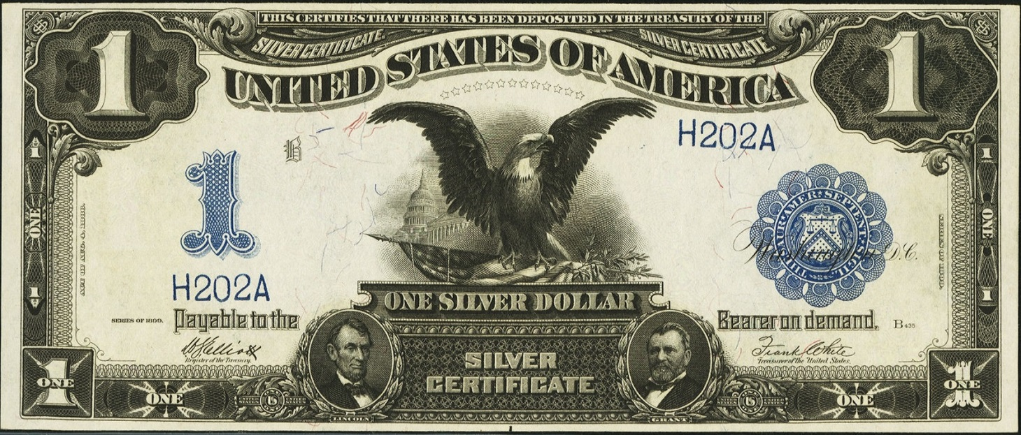
Catch #2
Low numbered notes and limited run star notes were numbered on paging machines
Typically serials below 1000
Notes:
Low numbered notes were usually numbered on paging machines, because of the overhead involved in adding a character on the rotary press.

Slide 57
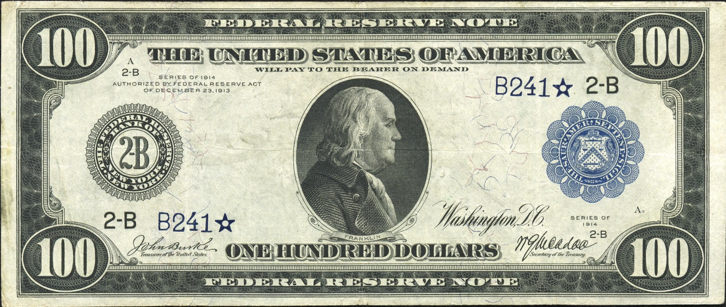
Another one
Notes:
Low serial number (<1000), numbered on paging machine. Happens to be a star. It is not a replacement replacement.

Slide 58
Presenting…
Pre-Star Replacement Notes
Notes:
Now I can show you pre-star replacements…

Slide 59
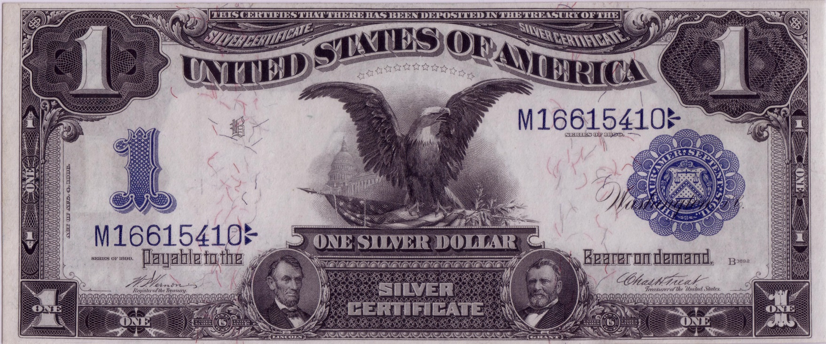
Pre-Star Replacement
Notes:
Here is a Fr. 228 (Vernon – Treat signatures) that is a pre-star replacement.

Slide 60
Printed from the same numbering head
Notes:
Let’s go through the diagnostics.
Printed after 1903 – check the table – M block is post-1903.
Has old style fonts indicative of paging machine – check.
Notice the first “1” is different. Focus on the last six digits.
Both serials printed from the same numbering head – check.

Slide 61
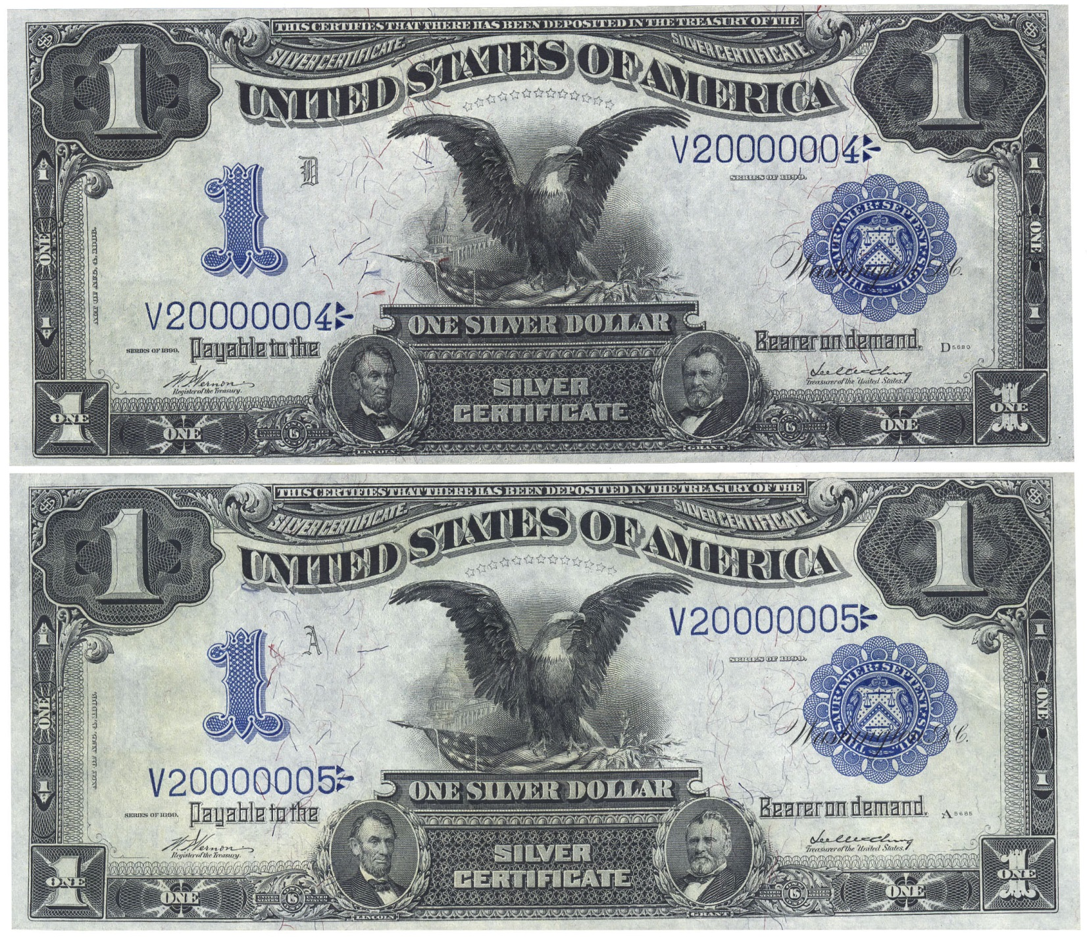
Notes:
Here is a neat pair.
This is the only known changeover pair from PSR to regular production note.
The top note was the first of a printing run – typical for what we see for make-up notes, especially in the national bank note series.

Slide 62
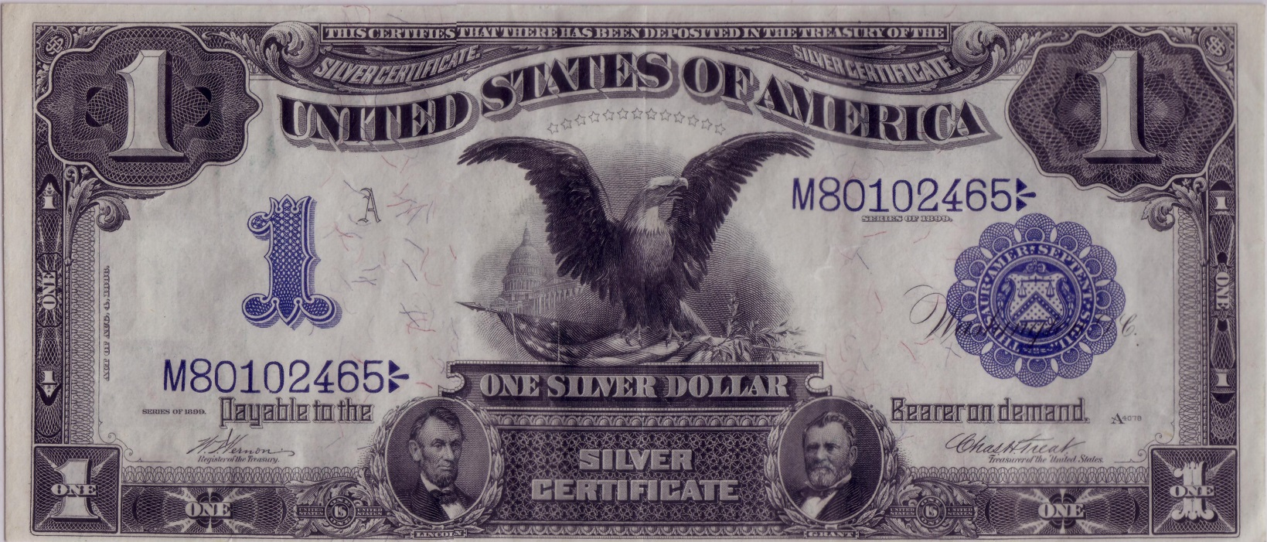
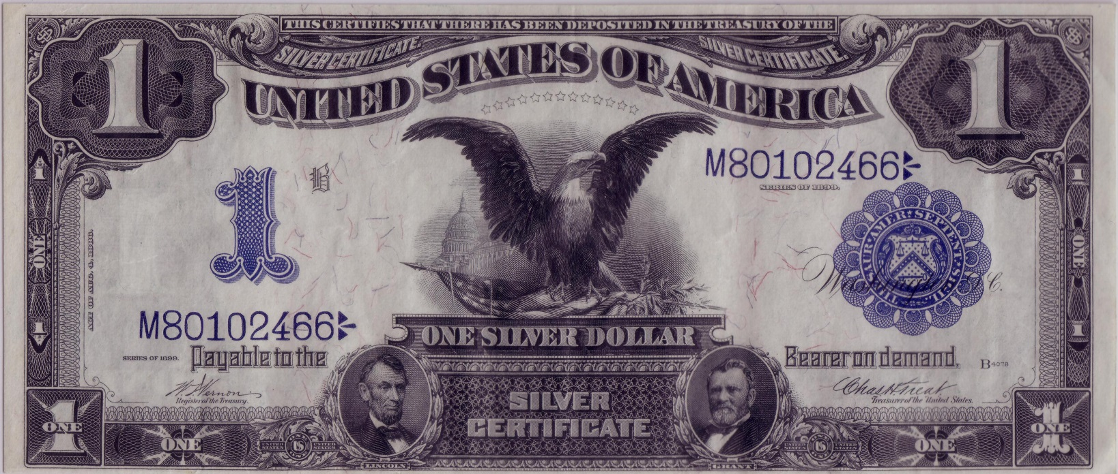
Notes:
Consecutive pair of PSRs from the A and B positions of the sheet.

Slide 63
Four impressions, same head
Notes:
What we can take from this is a comparison of the four numbers on these two notes.
Notice that they were printed from the same numbering head. Especially note the weakness at the bottom of the second “0”.

Slide 64
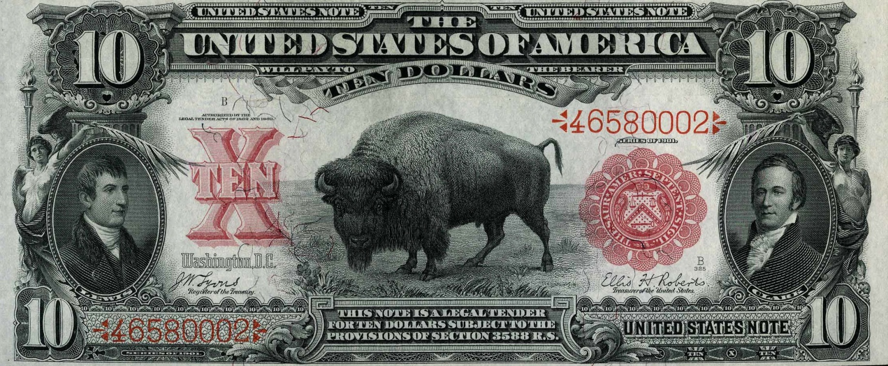
Pre-Star Replacement
Notes:
This PSR is another one that is from the first of its printing run.

Slide 65
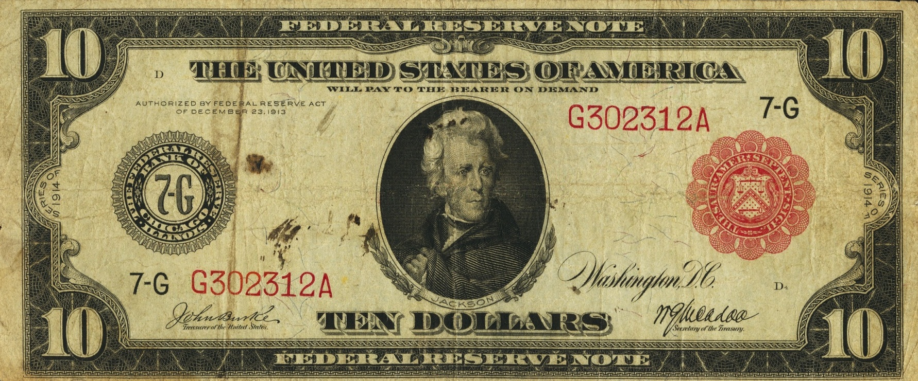
Pre-Star 1914 FRN Replacement
Notes:
Here is a 1914 PSR. As you all know, stars were not used on 1914 red seals.

Slide 66
But, wait!
You said stars were introduced in 1910.
How is it that a 1914 note can be a PSR?
Notes:
But, you said stars were introduced in 1910.

Slide 67
1914 Federal Reserve Notes
Why were there Pre-Star replacements for FRNs?
FRNs were considered bank currency, like national bank notes.
It was the continued practice to make exact replacements for nationals even after star notes were introduced for type
Notes:
…Silvers, Golds, Legals were Treasury obligations. FRNS were like NBNs, obligations of banks.

Slide 68
1914 Federal Reserve Notes
Until 1918…
First star notes for FRNs were made for Boston $5s on August 28, 1918.
Stars were introduced for higher denominations into 1920
Like other type, stars were not made for $500 and higher notes
Notes:
For FRNs, this lasted until 1918. Another policy change made in the name of efficiency.

Slide 69
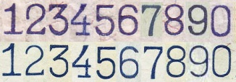
Fonts are a bit different
Notes:
Comparison of paging machine fonts (upper row) and regular production fonts (lower row).

Slide 70
Pre-Star 1914 FRN Replacement
Notes:
The discovery of this note at a coin shop in Fargo set off this research.

Slide 71
Statistics
For the data junkie

Slide 72
How many are out there?
These are very rare
Just 13 observed so far
Very short window
1903-1910 for Silvers, Golds, and LTNs
1914-1918 for FRNs
Rate of replacements for Black Eagles known to be about 1 in 150.
Implies about 5 million Black Eagle PSRs printed.
Star survival rate of about 0.005%
Implies about 250 Black Eagle PSRs are extant.
Notes:
Think this number is high. I’ve seen a lot of Black Eagles. I’ve found eight.

Slide 73
Put in context
Notes:
Of the 4000 notes in this package, about 27 were replacements.
But where are they?
Let the hunt begin!

Slide 74
Questions?
Get your handouts before you leave!

Slide 75
The End
References:
Bureau of Engraving and Printing, 1914, Central correspondence files of the Bureau of Engraving and Printing, Record Group 318, locator 450/79/10/5 box 13, national currency, defective: U. S. National Archives, College Park, MD
Google Patents website: http://www.google.com/patents/US155765 (accessed January 1, 2013).
Heritage Auction Archives website: ha.com
Huntoon, Peter. United States Large Size National Bank Notes. Laramie, WY: The Society of Paper Money Collectors, 1995.
Johnson, Frances Benjamin, photographer. “[Women operating machinery at the Bureau of Engraving and Printing]” Photograph. Washington, D.C.: 1889 or 1890. From Library of Congress: Digital Collections. http://www.loc.gov/pictures/item/96501566/ (accessed January 1, 2013).
Johnson, Frances Benjamin, photographer. “Bureau of Engraving and Printing, Wash., D.C.” Photograph. Washington, D.C.: c1889. From Library of Congress: Digital Collections. http://www.loc.gov/pictures/item/96502941/ (accessed January 1, 2013).
Meredith, William M. The Making of Government Securities. Washington, D.C.: Bureau of Engraving and Printing, 1904.
National Currency Foundation website: nbncenus.com
Underwood & Underwood, photographer. “[Woman operating machinery at the Bureau of Engraving and Printing]” Photograph. Washington, D.C.: c1908. From Library of Congress: Digital Collections. http://www.loc.gov/pictures/item/2006692626/ (accessed January 1, 2013).
U.S. Treasury Department, 1903, Annual Report of the Director of the Bureau of Engraving and Printing: U.S. Government Printing Office.

